Slide 1
Image Translation
Using CycleGAN
Summer Training Project
Saksham Gupta(CO16349)

Slide 2
Some Background Knowledge First
Machine Learning
Artificial Neural Networks
Generative Adversarial Networks

Slide 3
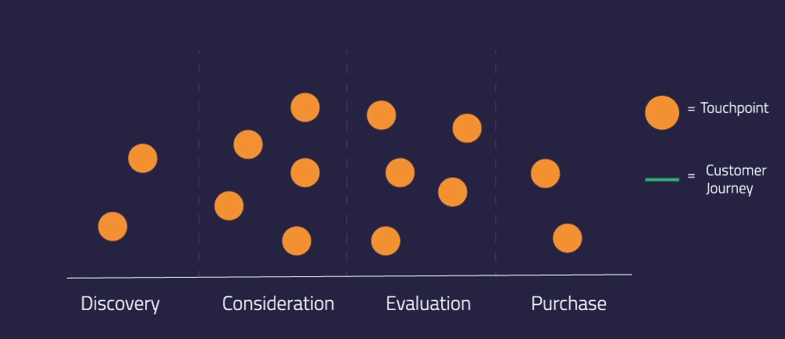
Machine Learning

Slide 4
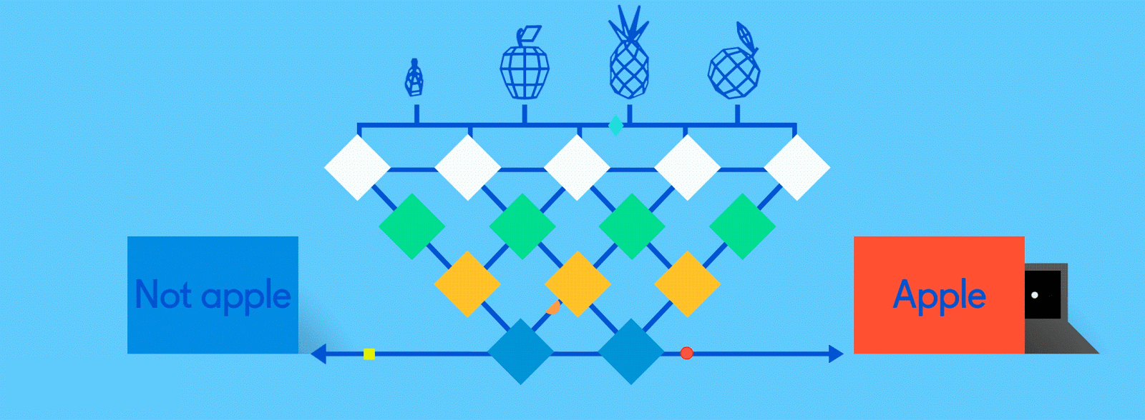
Artificial Neural Network

Slide 5

Convolutional Neural Network

Slide 6
Basic Concept
A Convolutional Neural Network (ConvNet/CNN) is a Deep Learning algorithm which can take in an input image, assign importance (learnable weights and biases) to various aspects/objects in the image and be able to differentiate one from the other.
The pre-processing required in a ConvNet is much lower as compared to other classification algorithms.
While in primitive methods filters are hand-engineered, with enough training, ConvNets have the ability to learn these filters/characteristics.
The architecture of a ConvNet is analogous to that of the connectivity pattern of Neurons in the Human Brain and was inspired by the organization of the Visual Cortex.

Slide 7
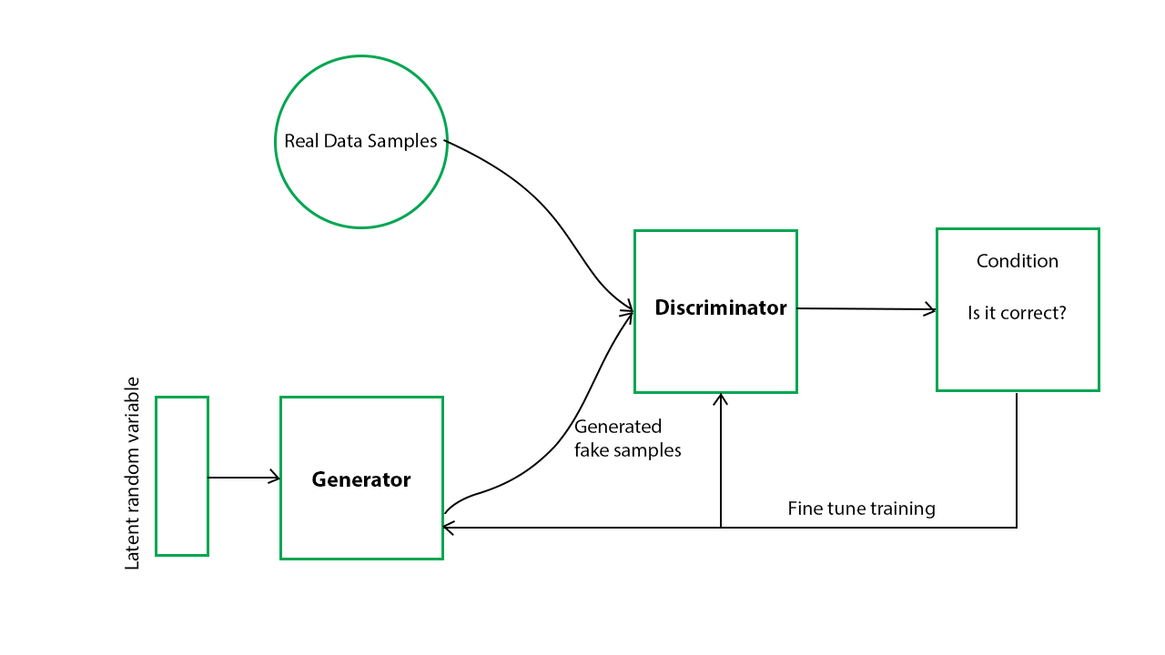
Generative Adversarial Network (GAN)

Slide 8
Basics of GAN
Generative Adversarial Networks (GANs) are a powerful class of neural networks that are used for unsupervised learning.
Generative Adversarial Networks (GANs) can be broken down into three parts:
Generative: To learn a generative model, which describes how data is generated in terms of a probabilistic model.
Adversarial: The training of a model is done in an adversarial setting.
Networks: Use deep neural networks as the artificial intelligence (AI) algorithms for training purpose.

Slide 9
Different Types of GAN
Vanilla GAN: This is the simplest type GAN. Here, the Generator and the Discriminator are simple multi-layer perceptrons.
Conditional GAN (CGAN): In CGAN, an additional parameter ‘y’ is added to the Generator for generating the corresponding data.
Deep Convolutional GAN (DCGAN): DCGAN is composed of ConvNets in place of multi-layer perceptrons. The ConvNets are implemented without max pooling, which is in fact replaced by convolutional stride.
Super Resolution GAN (SRGAN): SRGAN as the name suggests is a way of designing a GAN in which a deep neural network is used along with an adversarial network in order to produce higher resolution images.

Slide 10
Implementation
We implemented CycleGAN using fastai . We used Resnet Blocks in our generator, and we created two resnet generators and two discriminators.
The main loss used to train the generators. It has three parts:
The classic GAN loss: they must make the critics believe their images are real
identity loss: if they are given an image from the set they are trying to imitate, they should return the same thing
cycle loss: if an image from A goes through the generator that imitates B then through the generator that imitates A, it should be the same as the initial image. Same for B and switching the generators

Slide 11
CycleGAN Generator
Each CycleGAN generator has three sections: an encoder, a transformer, and a decoder.
The input image is fed directly into the encoder, which shrinks the representation size while increasing the number of channels.
The encoder is composed of three convolution layers. The resulting activation is then passed to the transformer, a series of six residual blocks. It is then expanded again by the decoder, which uses two transpose convolutions to enlarge the representation size, and one output layer to produce the final image in RGB

Slide 12
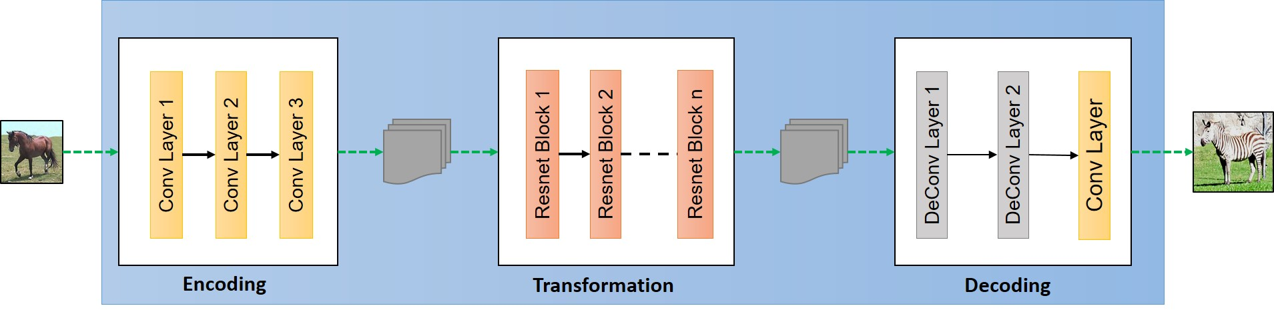
Generator

Slide 13
CycleGAN Discriminator
The discriminators are PatchGANs, fully convolutional neural networks that look at a “patch” of the input image and output the probability of the patch being “real”.
This is both more computationally efficient than trying to look at the entire input image and is also more effective — it allows the discriminator to focus on more surface-level features, like texture, which is often the sort of thing being changed in an image translation task.

Slide 14
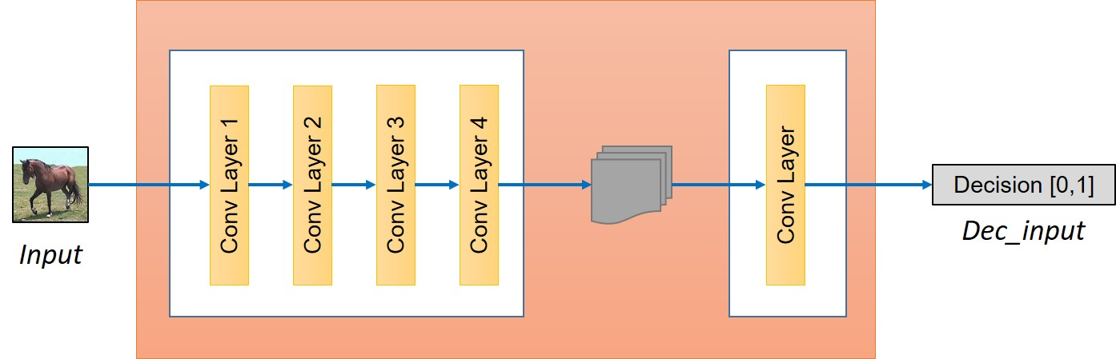
CycleGAN Discriminator

Slide 15
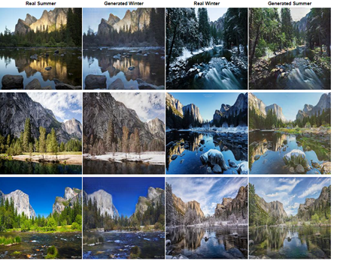
Results

Slide 16
Applications of CycleGAN
Style Transfer
Object Transfiguration
Photograph Generation From Paintings
Image Encoding and decoding
Photograph Enhancement

Slide 17
THANK YOU

